Slide 1
Open Security Standards and their Adoption Mapping José Legatheaux Martins – New University of Lisbon and ISOC Portugal

Slide 2
Trust and Security on the Internet
The principles of the basic architecture of the Internet have always favoured simplicity and scalability over security
This was a clever decision at that time, since it prevented the adoption of wrong solutions to then poorly understood problems and technologies, which would make the Internet architecture centralized, fragile and unable to scale and evolve.
Thus, trust and security are dependent of the generalized adoption of a set of security standards that are introduced, year after year, and then (slowly) deployed by the relevant actors

Slide 3
When Accessing a Certain URL, We Must Trust
That the DNS mapping to an IP address is genuine
That the routing system is passing packets to the correct endpoint / interface
That the TLS connection and the site certificate are genuine
That the Web Public Key Infrastructure is not corrupted
That others cannot sniff which site I am trying to access

Slide 4
Not all Internet Actors Implement all Possible Security Standards
Does some DNS domain is secured with DNSSEC?
Does my DNS resolution provider (resolver) implements DNSSEC?
Does my ISP implements routing security measures?
Do the sites I visit implement HTTPS with all up to date options and really genuine certificates?

Slide 5
Agenda
Mapping DNSSEC validation progress
Mapping HTTPS adoption progress

Slide 6
DNSSEC Deployment Worldwide
It is easy to test if the domain name of a site is DNSSEC certified
However, I couldn’t easily find figures on the percentage of domain zones implementing DNSSEC
Anyway, for those that implement it, do end users receive the benefits of its adoption?
In general, end-system outsource to the so-called resolvers the hard work of navigating the DNS
Do these resolvers perform DNSSEC validation when DNSSEC information is available?

Slide 7
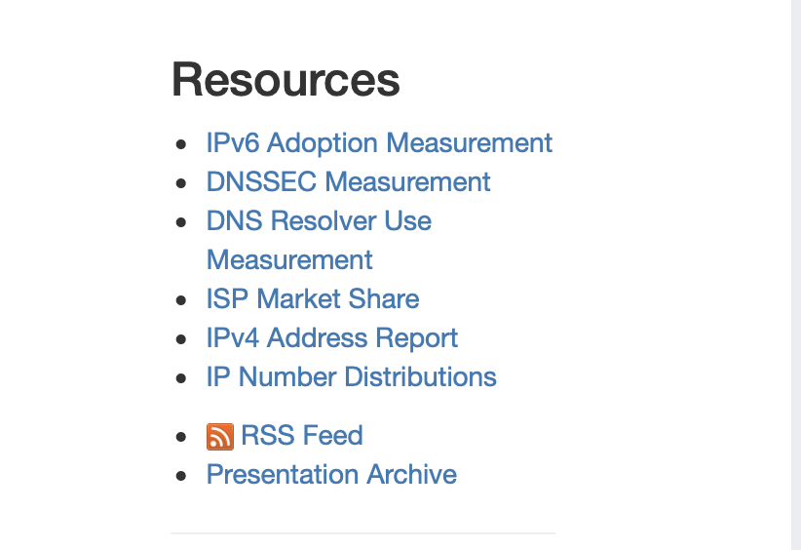
DNSSEC Validation Adoption as Seen Using APNIC Observatories
APNIC Laboratories, lead by Geof Houston, setup an extensive Internet Monitoring Infrastructure
Main goal (in this context): monitor, under the point of view of users, if their resolver providers implement DNSSEC Validation

Slide 8
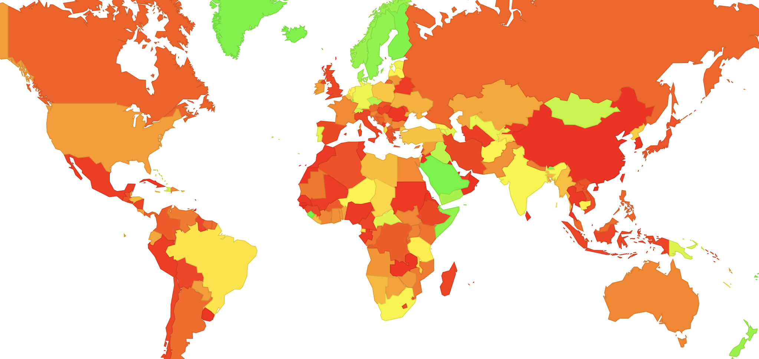
DNSSEC Validation Availability Worldwide
Verifying all DNSSEC signatures by the end systems is not realistic. Thus, users are dependent of their resolvers providers doing it
In this map, green countries are those where most users receive DNSSEC verified information when it is available

Slide 9
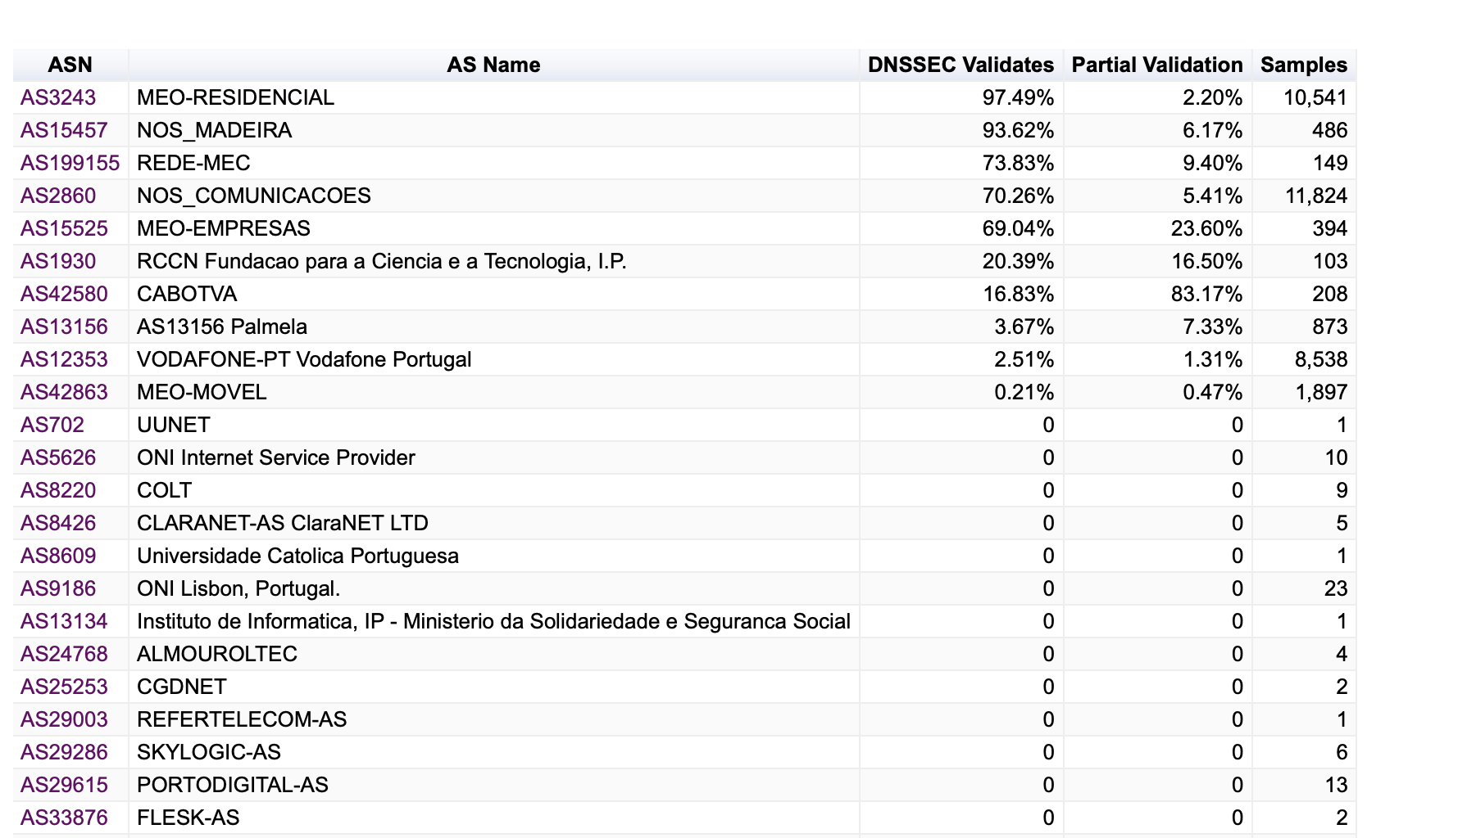
DNSSEC Validation Ratio per Provider in Portugal

Slide 10
HTTPS / TLS Deployment

Slide 11
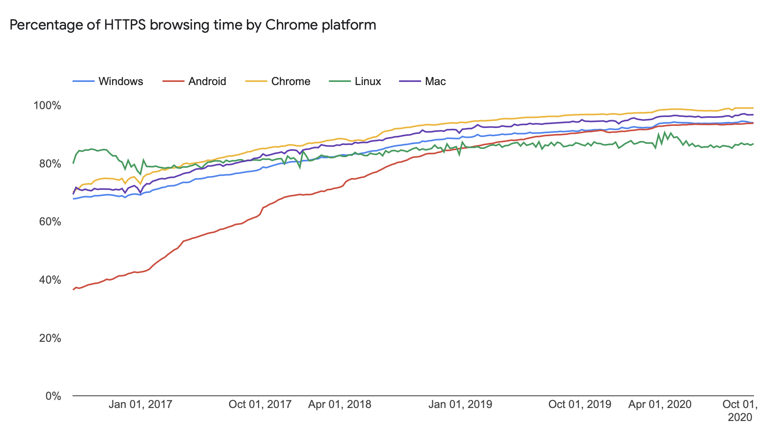
HTTPS Penetration as Seen From Chrome Telemetry
This is the percentage of HTTPS browsing time
Thus, it is not representative of the percentage of sites that use HTTPS
Source: https://transparencyreport.google.com/https/overview

Slide 12
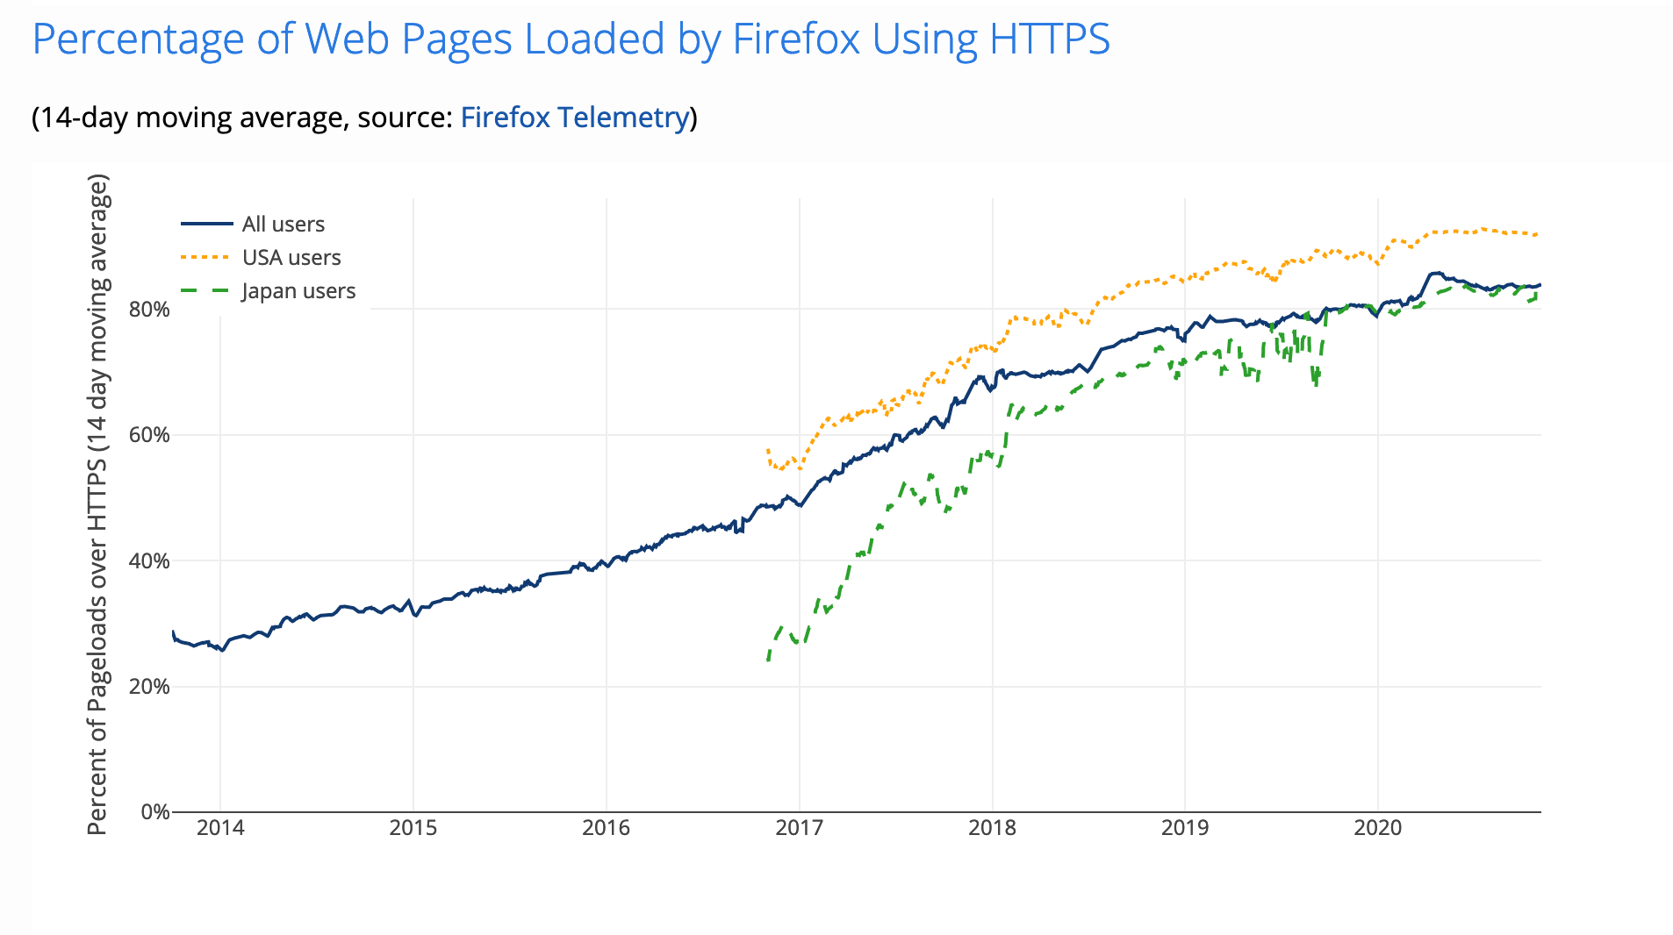
HTTPS Penetration as Seen From Firefox Telemetry
This is the percentage of Web Pages loaded using HTTPS
Thus, it is also not representative of the percentage of sites that use HTTPS
Source: https://letsencrypt.org/stats/

Slide 13
The Long Tail - HTTPS Penetration in 2017
Source: Measuring HTTPS Adoption on the Web — Adrienne Porter Felt, Google; Richard Barnes, Cisco; April King, Mozilla; Chris Palmer, Chris Bentzel, and Parisa Tabriz, Google — in Proceedings of the 2017 USENIX Security Symposium

Slide 14
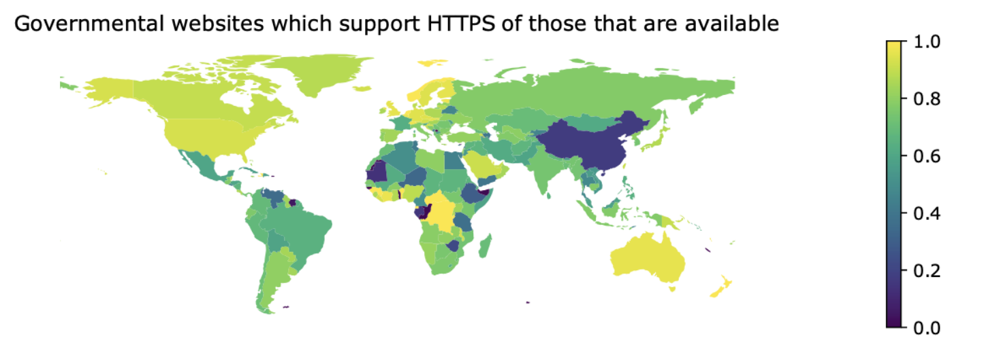
Example of the Long Tail – Governmental Sites
Percentage of visible governmental websites which support HTTPS of those that are available (made using a hand crafted set of governmental sites)
Source: https://blog.sudheesh.info/docs/2020-10-06-measuring-the-adoption-https-governments/

Slide 15
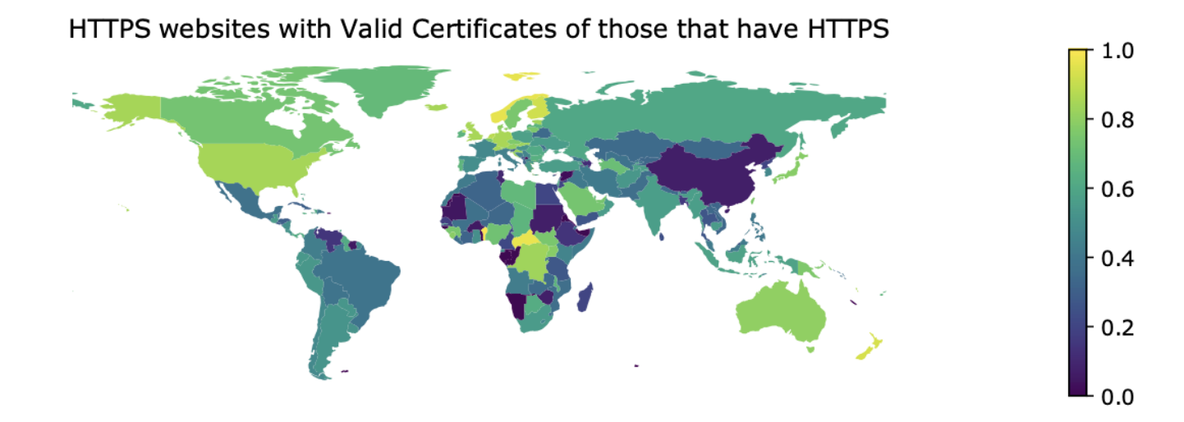
Support of Basic HTTPS is Not Enough
Percentage of govern-mental websites with valid certificates of those that have HTTPS
Source: https://blog.sudheesh.info/docs/2020-10-06-measuring-the-adoption-https-governments/

Slide 16
Support of Basic HTTPS is Not Enough
There are several options and details needed to ensure that a site does all it can do to support security
Examples of observatories and tools that perform extensive site tests
HTTPWatch (https://www.httpwatch.com)
Mozilla Observatory
CENSYS (https://censys.io)
HTTPS://INTERNET.NL
And probably many others

Slide 17
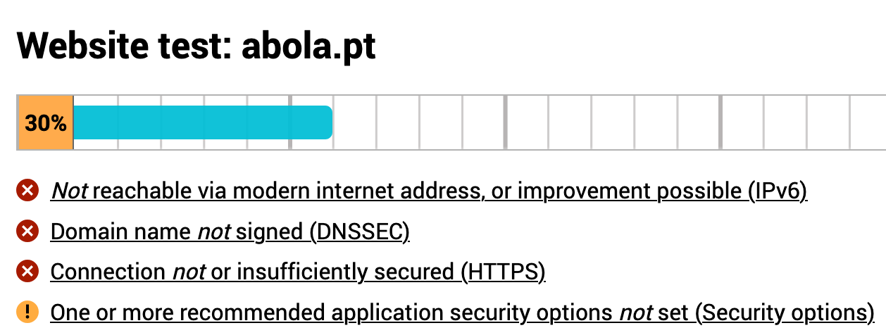
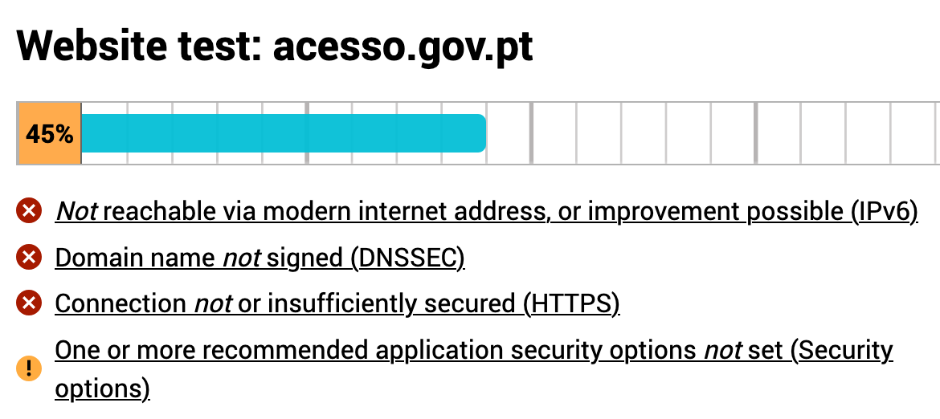
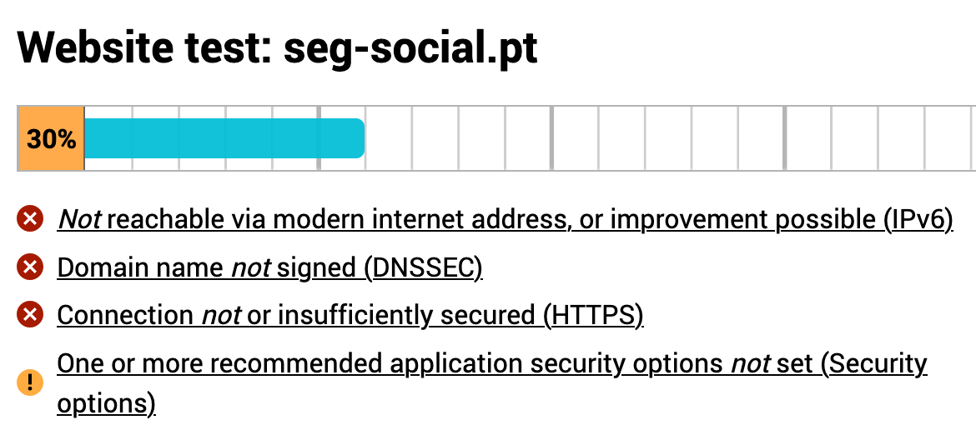
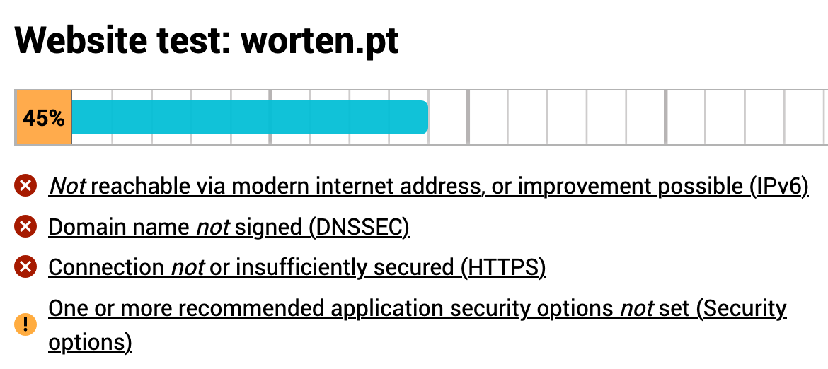
The Long Tail – Some Portuguese Alexa 50 Site Results

Slide 18
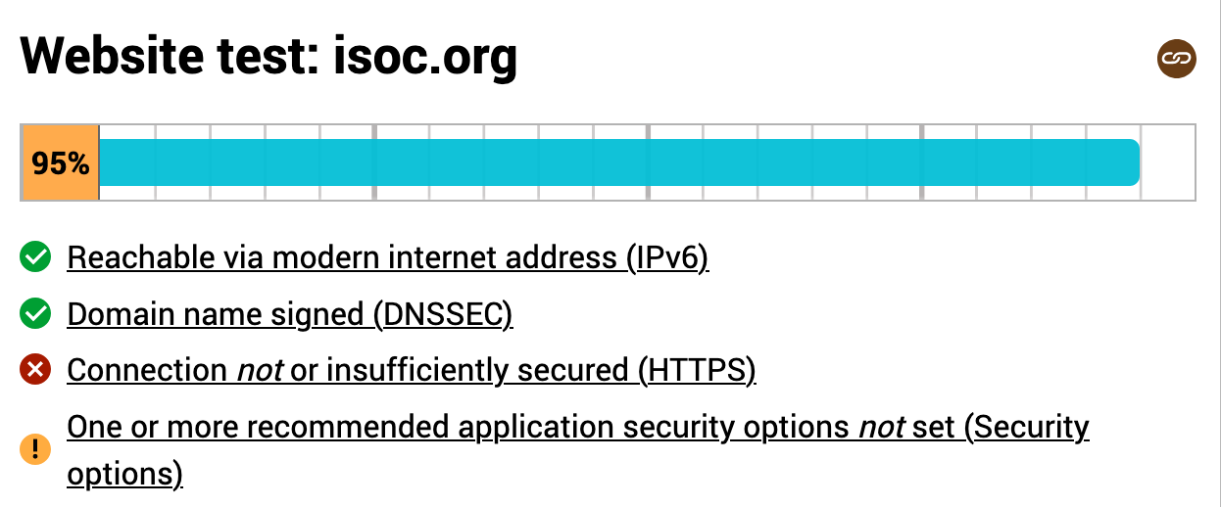
By Contrast
https://blog.sudheesh.info/docs/2020-10-06-measuring-the-adoption-https-governments/

Slide 19
Conclusions
Security and trust imply the generalized adoption of security open standards
Fully deploying these standards add burden, increase operational costs and do not immediately improve revenues (or impact in the public perception of a brand)
This may explain their slowly adoption rate
Public ignorance of the real adoption status may also help
Allowing users to have a more informed picture of the situation may improve the rate of adoption

Slide 20
Thanks for your attention. Questions?

